Slide 1
ThirdAI Hackathon
Team: Model.fit()
Enhancing Student Experience: AI-Powered Academic Advisory System for IIT Gandhinagar
Group Members:-
Vishal Ghoniya
Rahul Kumar
Sandeep Patel

Slide 2
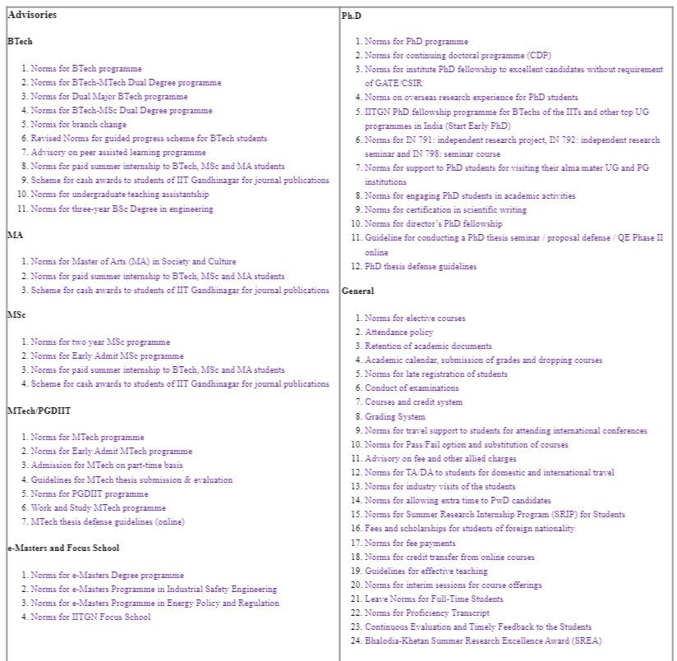
Problem Statement:
Emphasize the challenge of navigating through extensive PDF documents for academic advisories.
Highlight the time-consuming and often frustrating process of searching for relevant information.
Explain how the proposed AI solution aims to address this issue.

Slide 3
Solution
Present the AI-powered Academic Advisory System as the solution.
We have used the model provide by thirdAI named neural_db and to show the answer we have used openAI.
Describe how the system works: Users input queries, and the AI model generates relevant answers.

Slide 4
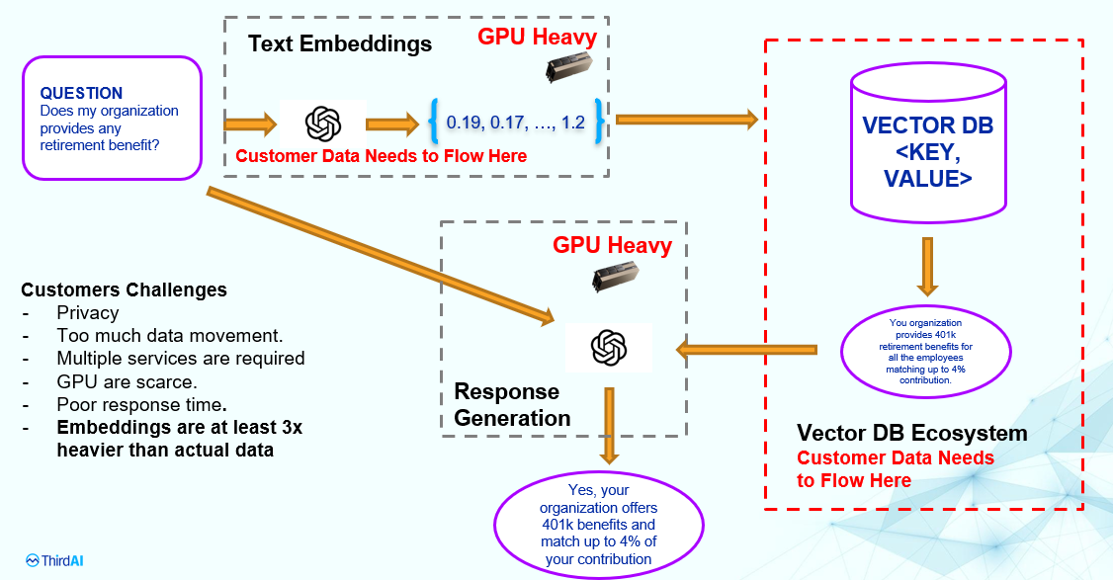
Solution

Slide 5
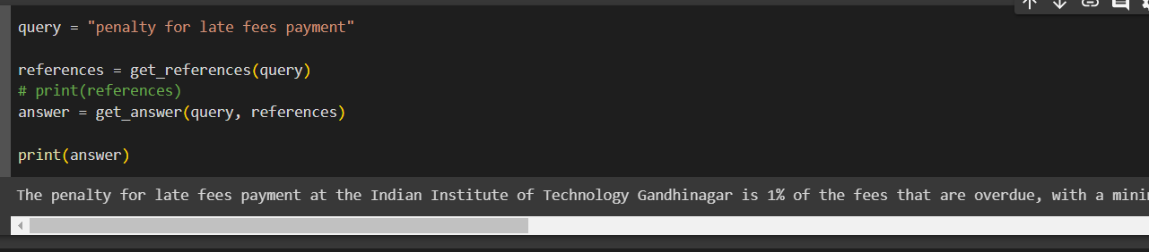
Sample Example
Query: - “penalty for late fees payment.”
Response:- The penalty for late fees payment at the Indian Institute of Technology Gandhinagar is 1% of the fees that are overdue, with a minimum penalty of Rs. 500. Additionally, if a student fails to pay the fees within 30 days of the registration date for that semester, their registration for that semester may be cancelled (Academic Affairs Advisory 45, 2019).

Slide 6
Benefits
Outline the advantages of the AI-powered Academic Advisory System:
- Time-Efficient: Instant access to information without lengthy document searches.
- Reduced Frustration: Eliminate the hassle of navigating complex PDFs.
- Improved Student Experience: Enhance the overall satisfaction of students.
- Increased Productivity: Allow students to focus more on academics and personal

Slide 7
Future Enhancements
Present possibilities for future development and expansion:
Other Advisories Support: - Extend the system to other advisories available on the IITGN website.
User-Friendly Interface: Easy-to-use and intuitive design.
Multilingual Support: Extend the system to accommodate different languages.
Personalization: Tailor responses based on user profiles and preferences.
Integration: Link the system with other university services for a comprehensive student experience.

Slide 8
References
Note:- We can’t provide the database because advisories are confidential. Contact vishal.ghoniya@iitng.ac.in for the live demo.
We can’t share the dataset we used to train the model as they are very confidential. So we have also provided sample dataset containing some books which can serve the purposes.

